Slide 1

Gold Loan Management
Presented by:
Renjith Anil(22BAI1050)

Slide 2
Introduction and abstract
The "Gold Loan Management System" is a database management system designed to handle the process of gold loan applications and management. The system will accept applicant data, assess loan eligibility, and present available gold loan plans to users. Upon selection of a plan, the system will create and maintain entries in the database to track monthly payments and manage the risk of default.
This project aims to streamline the gold loan application and management process for both the financial institution and the loan applicants.

Slide 3
Importance of an efficient gold management System
Risk Mitigation: Efficient gold loan database management helps in mitigating risks by enabling accurate tracking of loan disbursements, customer details, and gold assets, contributing to better risk assessment and management.
Data Organization: Well-managed databases facilitate the organized storage of customer details, loan information, and gold assets, ensuring streamlined operations and efficient data retrieval.
Regulatory Compliance: Effective management supports regulatory compliance, minimizing potential errors, ensuring data integrity, and contributing to financial transparency and risk management.
Customer Service Enhancement: Properly managed databases enable swift processing, effective communication regarding loan status, and improved customer service, enhancing overall customer experience and satisfaction.

Slide 4
Flow Chart
2.a
2.b
2.
1
3.
3.a
4.
5.
4.a
6.
7.

Slide 5
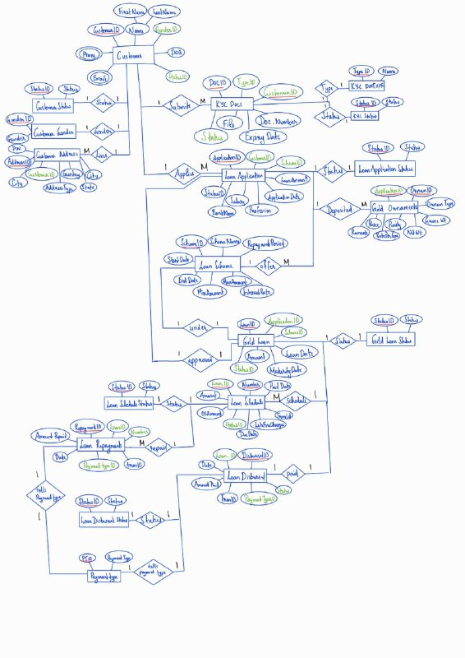
Entity-Relationship Diagram

Slide 6
Key components in the ER-Diagram
Loan scheme
Customer
KYC Docs
Customer Address
Loan Application
Gold Ornaments
Gold Loan
Loan Schedule
Loan Disbursal
Loan Repayments

Slide 7
Relationships bEtween the key Components
1. Loan Scheme:
Mapping Cardinality and Relationship Nature:
LoanScheme-to-Loan Application: A gold scheme can be offered to multiple Loan Applications(1:M)
LoanScheme-to-GoldLoan: A gold loan is taken under a loan scheme(1:1)
2. Customer:
Mapping Cardinality and Relationship Nature:
Customer-to-LoanApplication: One Customer can apply for multiple LoanApplication (1:M)
Customer-to-KYCDocs: One Customer can submit multiple KYCDocs.(!:M)
Customer-to-CustomerAddress: One customer can have multiple addresses (permanent/temporary)(1:M)

Slide 8
2.a. KYCDocs:
Mapping Cardinality and Relationship Nature:
KYCDocs-to-Customer: Multiple KYCDocs can be submitted by one customer(M:1)
2.b. CustomerAddress:
Mapping Cardinality and Relationship Nature:
CustomerAddress-to-Customer: Multiple Addresses of different types can be written under on Customer (M:1)
3. LoanApplication:
Mapping Cardinality and Relationship Nature:
LoanApplication-to-Customer: Multiple LoanApplication can be applied by one Customer(M:1)
LoanApplication-to-GoldOrnaments: A Loan Application can have multiple Gold ornaments deposited under it.(1:M)

Slide 9
3.a. Gold Ornaments:
Mapping Cardinality and Relationship Nature:
Gold Ornaments-to-LoanApplication: Multiple GoldOrnaments can be submitted to one LoanApplication(M:1)
4. Gold Loan:
Mapping Cardinality and Relationship Nature:
Gold Loan-to-LoanApplication: A Gold loan is created only when a loan application is approved(1:1)
Gold Loan-to-LoanScheme: A Gold Loan can only exists under one LoanScheme(1:1)
Gold Loan-to-LoanSchedule: A Gold Loan can have multiple Loan Schedules depending on the type of repayment method the customer chose.(1:M)
Gold Loan-to-LoanDisbursal: A gold loan can only disburse the loan amount to the customer once(1:1)
4.a. Loan Schedule:
Mapping Cardinality and Relationship Nature:
Loan Schedule-to-Gold Loan: Multiple Loan Schedules can be schedules for one gold loan(M:1)
Loan Schedule-to-Loan Repayments: An emi repayment/lumpsum repayment can be done using multiple loan repayments(1:M)

Slide 10
5. Loan Disbursal:
Mapping Cardinality and Relationship Nature:
Loan Disbursal-to-Gold Loan: Disbursal of the loan amount can only be done once by the gold loan(1:1)
6. Loan Repayments:
Mapping Cardinality and Relationship Nature:
Loan Repayments-to-LoanSchedule: Mulitple repayments can be done to pay off one of the loan emi amount (M:1)

Slide 11
Visualization using examples
1. Loan Scheme
Scheme_ID | Scheme_name | StartDate | EndDate | MaxAmount | MinAmount | InterestRate | RepaymentPeriod
101 | Gold Loan Scheme 1 | 2024-01-01 | 2024-12-31 | 100000.00 | 5000.00 | 8.00 | 36
102 | Gold Loan Scheme 2 | 2024-02-15 | 2024-12-31 | 150000.00 | 10000.00 | 7.50 | 24
2. Customer
CustomerID | First_Name | Last_Name | GenderID | DOB | StatusID
1 | Renjith | Anil | 1 | 1990-05-15 | 1
2 | Aditi | Rao | 2 | 1985-08-20 | 2

Slide 12
2.1. Customer Status Table
StatusID | STATUS
1 | Active
2 | Inactive
2.2. Customer Gender Table
GenderID | Gender
1 | Male
2 | Female
2.3. Customer Phone Number Table
PhoneID | CustomerID | Phone_Number
1 | 1 | 123-456-7890
2 | 1 | 987-654-3210

Slide 13
2.4. Customer Email Table
EmailID | CustomerID | Email
1 | 1 | renjith.anil@gmail.com
2 | 1 | renjithaniltvm@gmail.com
2.a. KYCDocs Table
CustomerID | DOC ID | DOC_NUMBER | ExpiryDate | TypeID | Status
1 | 1 | 123456 | 2025-12-31 | 1 | 1
2 | 2 | 987654 | 2024-10-15 | 2 | 2
2.a.1 KYC Status Table
StatusID | STATUS
1 | Verified
2 | Not Verified

Slide 14
2.a.2 KYC DOCType Table
TypeID | Name
1 | Aadhar
2 | PanCard
2.b. Customer Address Table
AddressID | CustomerID | Address | AddressType | Country | State | City | Pincode
1 | 1 | 123 Main St | Permanent | USA | California | Los Angeles | 90001
2 | 1 | 456 Elm St | Temporary | Canada | Ontario | Toronto | M5V 2H1
3. Loan Application Table
ApplicationID | CustomerID | SchemeID | ApplicationDate | LoanAmount | Profession | Salary | Bank_card_number | Status
1 | 1 | 101 | 2024-03-15 | 50000.00 | Engineer | 60000.00 | 1234567890123456 | 3
2 | 2 | 102 | 2024-03-20 | 75000.00 | Teacher | 45000.00 | 9876543210987654 | 1

Slide 15
3.1. Loan Application Status Table
StatusID | STATUS
1 | Pending
2 | Rejected
3 | Accepted
3.a Gold Ornament Table
ApplicationID | OrnamID | Ornam_Type | Gross_Weight | Net_Weight | Purity | RatePerGram | Price | Remark
1 | 1 | Ring | 10.00 | 9.50 | 22.00 | 4000.00 | 38000.00 | Good condition
1 | 2 | Necklace | 30.00 | 28.50 | 24.00 | 4200.00 | 119700.00 | Slight scratches
4. Gold Loan table
Loan_ID | Application_ID | LoanAmount | LoanDate | MaturityDate | Scheme_ID | Status
1 | 1 | 50000.00 | 2024-03-15 | 2025-03-15 | 101 | 1
2 | 2 | 75000.00 | 2024-03-20 | 2025-03-20 | 102 | 2

Slide 16
4.1. GoldLoan Status Table
StatusID | STATUS
1 | Ongoing
2 | Closed
4.a. Loan Schedule Table
Loan_ID | Numb | Amount | OSAmount | PaidDate | DueDate | LateFineCharges | Status
1 | 1 | 2000.00 | 0 | 2024-04-01 | 2024-05-01 | 0 | 3
1 | 2 | 2000.00 | 1000.00 | 2024-05-01 | 2024-06-01 | 0 | 2
1 | 3 | 3000.00 | 3000.00 |  | 2024-05-05 | 0 | 1
2 | 1 | 69000.00 | 69000.00 |  | 2024-06-05 | 75.00 | 1
4.a.1 Loan Schedule status table
StatusID | STATUS
1 | Unpaid
2 | Partially Paid
3 | Fully Paid

Slide 17
5. Loan Disbursal Table
Disbursal_ID | LoanID | AmountPaid | PaymentDate | PaymentTypeID | Transaction_ID | Status
1 | 1 | 50000.00 | 2024-03-15 | 1 | 123456 | 2
2 | 2 | 75000.00 | 2024-03-20 | 2 | 987654 | 2
5.1 Loan Disbursal StatusTable
StatusID | STATUS
1 | Unpaid
2 | Paid
5.2. Payment Type Table
PTID | PaymentType
1 | Cheque
2 | Bank Transfer
3 | Cash

Slide 18
6.Loan Repayment Table
RepaymentID | LoanID | Number | AmountRepaid | PaymentDate | PaymentTypeID | Transaction_ID
1 | 1 | 1 | 2000.00 | 2024-04-01 | 1 | 111111
2 | 1 | 2 | 2000.00 | 2024-05-01 | 1 | 222222
6.1 Payment Type Table
PTID | PaymentType
1 | Cheque
2 | Bank Transfer
3 | Cash
7. Closure: When the loan has been completely paid of, the statusID of the gold loan under the gold loan table gets converted to 2 which means the loan has been closed.

Slide 19
Thank You

